Slide 1
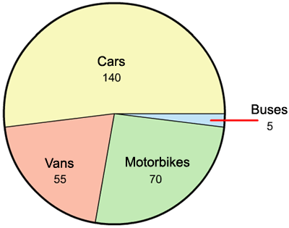
Make up a statement or a question for this graph using one or more of the following key words:
fraction, percentage, proportion

